Slide 1

Welcome
Notes:
Topic: Recalibration
Time: 30 minutes
Purpose of training evolution: Sailors will focus on the recalibration breathing technique and how to focus on breathing in specific situations or scenarios where recalibration would be most effective.
Expected outcome of training evolution: Sailors will learn that recalibration can be a lifelong practice.
Safety: Inform Sailors of safety hazards in the training environment. For some topics, Sailors should be informed if there is a designated person to talk to if the Sailor feels compelled to leave the training.
Facilitator Actions:
Display slide.
Greet Sailors.
Introduce yourself and give any background on yourself that might be of interest.
Establish credibility.
Facilitator Instructions:
The slide deck acts as a guide to present a facilitated discussion that may include activities.
Best practice: Use the slide to develop interest in the subject matter. Do not read the slides word for word. The Sailors should be able read the text and understand the messaging presented in the graphics.
Facilitator notes are available for each slide to help the Facilitator deliver the topic.
Best practice: Use the Slide Show view to ensure the Facilitator notes are viewable.
The Facilitator notes are divided into general instructions for Facilitator Actions (mechanics of facilitation) and the Facilitator Content (Inform, Discuss, Perform, and Reference).
Best practice for Inform: Present facts, concepts, and procedures. Depending on the subject matter, these may be written as suggested talking points or scripted material (denoted by quotation marks).
Best practice for Discuss: Conduct large-group question and answer sessions or large-group, Facilitator-led activities. Depending on the subject matter, these may be written as questions with expected answers or scripted activities.
Best practice for Perform: Facilitate small-group, scenario-based or procedural activities. Depending on the subject matter, these may be written with specific actions the Sailors will take or general ways for the Facilitator to monitor the activities. The Facilitator will be provided with expected outcomes to ensure Sailors leave training with correct information.
Best practice for Reference: This is for Facilitator use only.

Slide 2
Warrior Toughness
Introduction
MIND • BODY • SPIRIT
Recalibration
Notes:
Facilitator Actions:
Display slide.
Introduce topic.
Let Sailors know that they can leave the discussion if they have to for their own well-being.
Ensure that misinformation is corrected immediately.
Monitor the discussions of the Sailors throughout the training event.
Facilitator Content:
To build Warrior Toughness, Sailors will focus on the recalibration process, ways to personalize the process, how to recalibrate at their command, how to focus on breathing, and specific situations or scenarios where recalibration would be most effective.

Slide 3
Learning Objective
Recalibration is a breathing technique designed to slow down an individual’s heart rate and breathing. It is a skill that enables Sailors to refocus on the task at hand. Recalibration is not a break, a pause, or a time-out.
Notes:
Facilitator Actions:
Display slide.
Neither Sailors nor Facilitator should read the objective out loud.
Facilitator Content: N/A

Slide 4
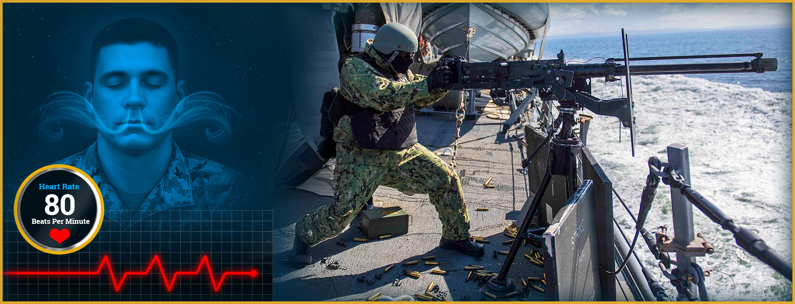
Recalibration
How does recalibration help you remain focused?
Notes:
Facilitator Actions:
Display slide.
Discuss how graphic relates to topic.
Monitor the discussions of the Sailors.
Facilitator Content:
Discuss:
What is recalibration?
Inform:
Recalibration is a breathing technique used to reduce the negative effects of stress or adrenaline in high-pressure situations.
It enables you to stay fully engaged in the task at hand without pausing.
Discuss:
How does recalibration help you remain focused?
Inform:
Recalibration helps you stay calm but alert in stressful situations.
Slow, controlled breathing can:
Lower heart rate.
Reduce blood pressure.
Improve memory.

Slide 5
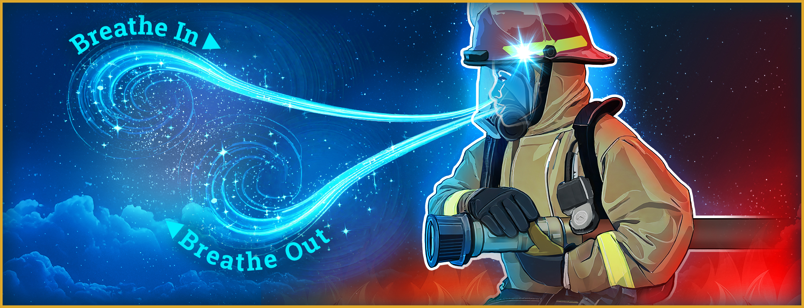
Practicing Recalibration Activity
How do you know if you are using the correct breathing technique?
Notes:
Facilitator Actions:
Display slide.
Monitor the discussions of the Sailors.
Facilitator Content:
Inform:
Use deep breathing or meditation to stay focused and reduce stress.
Discuss:
This exercise asks questions about recalibration and has the Sailors practice breathing.
Ask the following:
How do you know if you are using the correct breathing technique?
Directions for practicing recalibration:
This is not a relaxation technique; it is used to improve focus and performance.
Have the Sailors inhale slowly through their nose for 5 seconds, then exhale through their mouth for 7 seconds and repeat (inhaling and exhaling).
Ask the Sailors if they feel less stressed and more focused.
This exercise should not exceed 5 minutes.

Slide 6
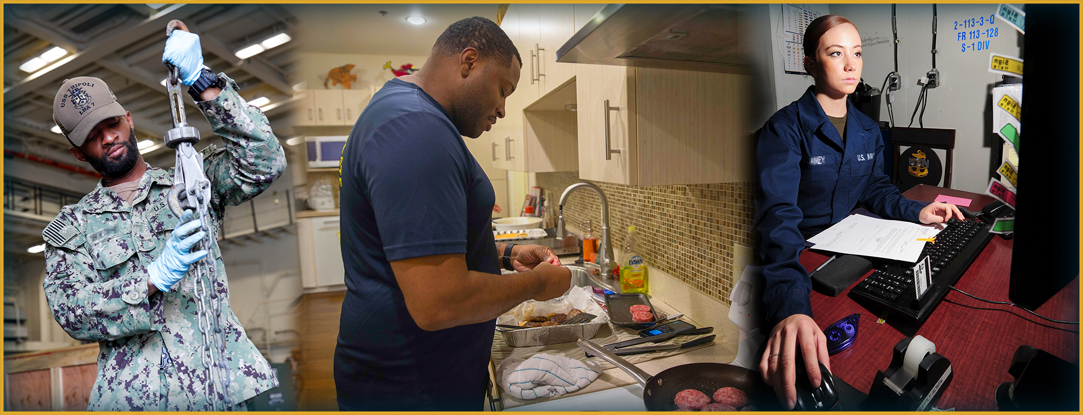
Muscle Memory Response
How can you practice recalibration during your daily routine?
Notes:
Facilitator Actions:
Display slide.
Discuss how graphic relates to topic.
Monitor the discussions of the Sailors.
Facilitator Content:
Inform:
Recalibration needs to be a muscle memory response.
Prepare yourself to handle high-stress situations by practicing recalibration regularly.
The goal is that your body will instinctively slow your breathing and heart rate in moments of danger.
Focus on incorporating controlled breathing into your daily routine.
Discuss:
How can you practice recalibration during your daily routine?

Slide 7
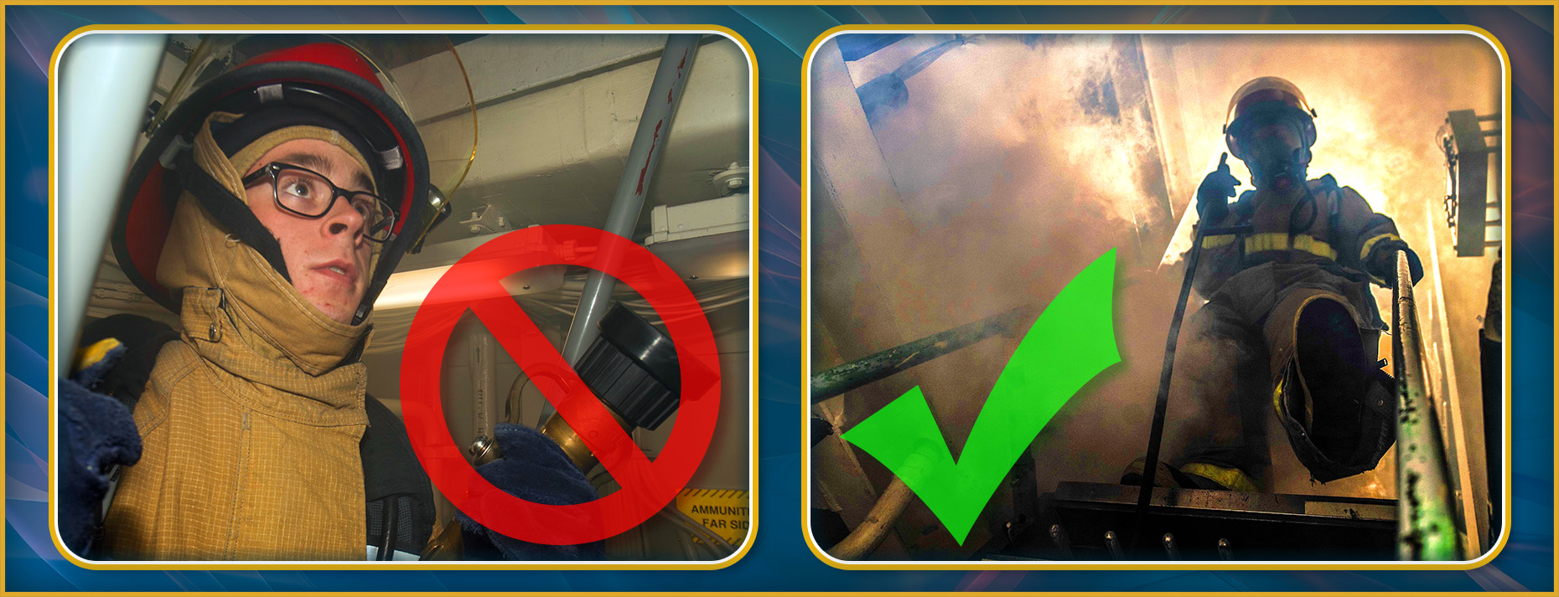
What Recalibration Is Not
How is recalibration used effectively?
Notes:
Facilitator Actions:
Display slide.
Discuss how graphic relates to topic.
Monitor the discussions of the Sailors.
Facilitator Content:
Inform:
Recalibration is NOT:
A break or pause
Mediation
Training Time Out (TTO)
Intentional recovery
Recalibration is performed in the moment without stopping.
Discuss:
How is recalibration used effectively?

Slide 8
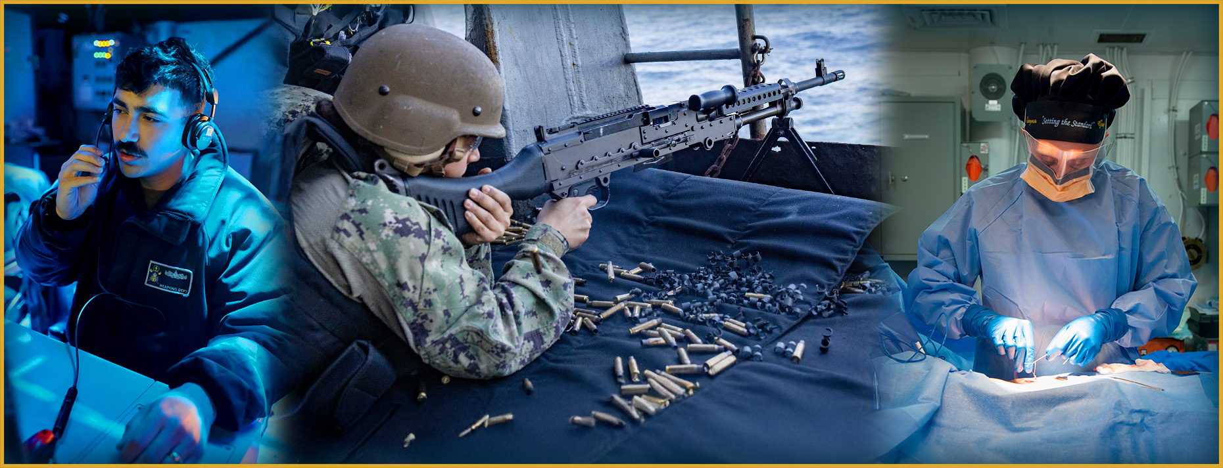
In the Moment
Where might you utilize recalibration as a tool at your command?
Notes:
Facilitator Actions:
Display slide.
Discuss how graphic relates to topic.
Monitor the discussions of the Sailors.
Facilitator Content:
Inform:
Recalibration helps you to manage stress and maintain mental clarity in high-pressure situations.
Discuss:
How would recalibration help Sailors in these situations?
In what other situations would recalibration help you to remain fully and continually engaged?
Where might you utilize recalibration as a tool at your command?

Slide 9

Call to Action
Practice recalibration and get back in the fight!
Notes:
Facilitator Actions:
Display slide.
Review topics discussed and ask if there are any questions.
Check Sailor comprehension by providing review questions and/or problems.
Discuss how the call to action supports and encourages Sailors’ post training.
Relate call to action to Warrior Toughness.
Facilitator Content: N/A

Slide 10
References
Tools and Resources
Warrior Toughness Terms
Warrior Toughness Placemat
Notes:
Facilitator Actions:
Display slide.
Facilitator Content:
Inform:
Identify tools.
Identify resources.

Slide 11
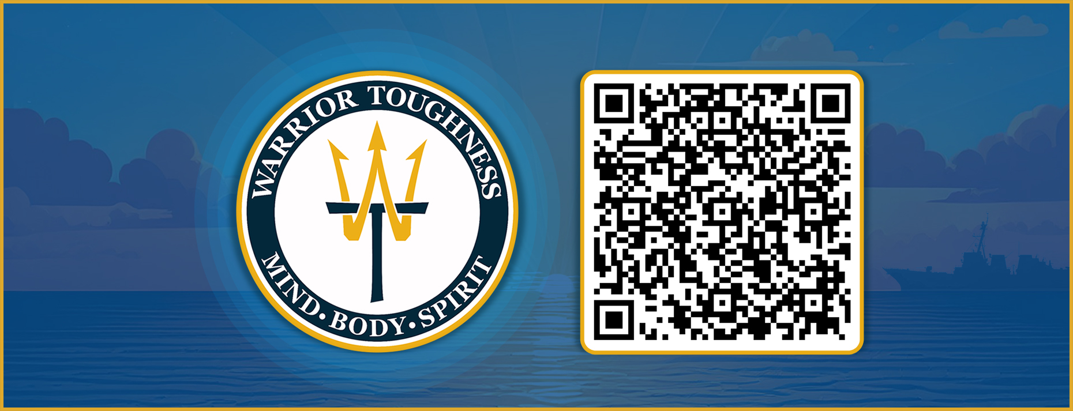
Warrior Toughness QR Code
Notes:
Facilitator Actions:
Display slide.
Facilitator Content:
Inform:
Identify Warrior Toughness QR code.

Slide 12
Glossary
Glossary
Acronym | Term
TTO | Training Time Out
WT | Warrior Toughness
Notes:
Facilitator Actions:
Display slide.
Facilitator Content: N/A

